Slide 1
Chapter 14:
More About Classes

Slide 2
14.1
Instance and Static Members

Slide 3
Instance and Static Members
instance variable: a member variable in a class. Each object has its own copy.
static variable: one variable shared among all objects of a class
static member function: can be used to access static member variable; can be called before any objects are defined

Slide 4
static member variable
Contents of Tree.h
1 // Tree class 2 class Tree 3 { 4 private: 5 static int objectCount; // Static member variable. 6 public: 7 // Constructor 8 Tree() 9 { objectCount++; } 10 11 // Accessor function for objectCount 12 int getObjectCount() const 13 { return objectCount; } 14 }; 15 16 // Definition of the static member variable, written 17 // outside the class. 18 int Tree::objectCount = 0;
Static member declared here.
Static member defined here.

Slide 5
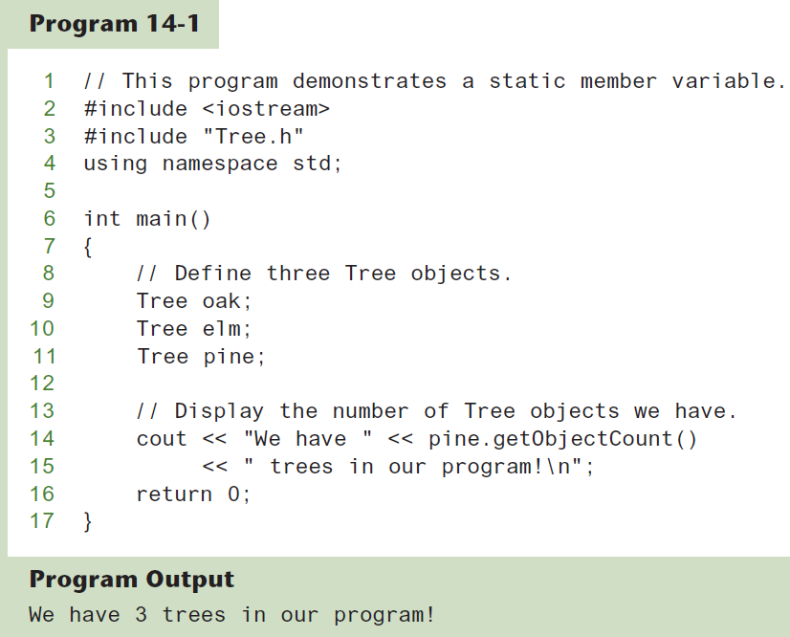

Slide 6
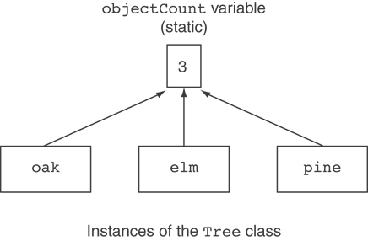
Three Instances of the Tree Class, But Only One objectCount Variable

Slide 7
static member function
Declared with static before return type:
static int getObjectCount() const
{ return objectCount; }
Static member functions can only access static member data
Can be called independent of objects: int num = Tree::getObjectCount();

Slide 8
Modified Version of Tree.h
1 // Tree class 2 class Tree 3 { 4 private: 5 static int objectCount; // Static member variable. 6 public: 7 // Constructor 8 Tree() 9 { objectCount++; } 10 11 // Accessor function for objectCount 12 static int getObjectCount() const 13 { return objectCount; } 14 }; 15 16 // Definition of the static member variable, written 17 // outside the class. 18 int Tree::objectCount = 0;
Now we can call the function like this: cout << "There are " << Tree::getObjectCount() << " objects.\n";

Slide 9
14.2
Friends of Classes

Slide 10
Friends of Classes
Friend: a function or class that is not a member of a class, but has access to private members of the class
A friend function can be a stand-alone function or a member function of another class
It is declared a friend of a class with friend keyword in the function prototype

Slide 11
friend Function Declarations
Stand-alone function:
friend void setAVal(intVal&, int);
// declares setAVal function to be
// a friend of this class
Member function of another class:
friend void SomeClass::setNum(int num)
// setNum function from SomeClass
// class is a friend of this class

Slide 12
friend Class Declarations
Class as a friend of a class:
class FriendClass
{
...
};
class NewClass
{
public:
friend class FriendClass; // declares
// entire class FriendClass as a friend
// of this class
…
};

Slide 13
14.3
Memberwise Assignment

Slide 14
Memberwise Assignment
Can use = to assign one object to another, or to initialize an object with an object’s data
Copies member to member. e.g.,
instance2 = instance1; means:
copy all member values from instance1 and assign to the corresponding member variables of instance2
Use at initialization:
Rectangle r2 = r1;

Slide 15
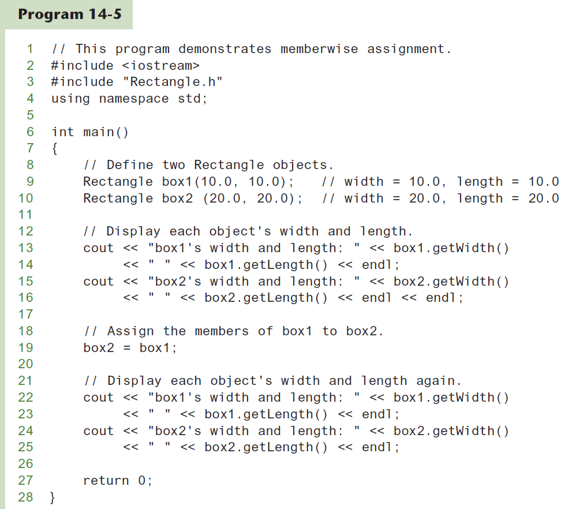

Slide 16
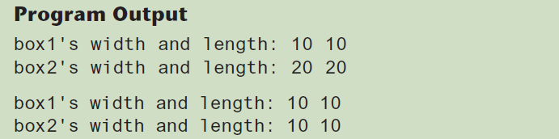

Slide 17
14.4
Copy Constructors

Slide 18
Copy Constructors
Special constructor used when a newly created object is initialized to the data of another object of same class
Default copy constructor copies field-to-field
Default copy constructor works fine in many cases

Slide 19
Copy Constructors
Problem: what if object contains a pointer?
class SomeClass
{ public:
SomeClass(int val = 0)
{value=new int; *value = val;}
int getVal();
void setVal(int);
private:
int *value;
}

Slide 20
Copy Constructors
What we get using memberwise copy with objects containing dynamic memory:
SomeClass object1(5);
SomeClass object2 = object1;
object2.setVal(13);
cout << object1.getVal(); // also 13
13
object1
object2
value
value

Slide 21
Programmer-Defined Copy Constructor
Allows us to solve problem with objects containing pointers:
SomeClass::SomeClass(const SomeClass &obj)
{
value = new int;
*value = obj.value;
}
Copy constructor takes a reference parameter to an object of the class

Slide 22
Programmer-Defined Copy Constructor
Each object now points to separate dynamic memory:
SomeClass object1(5);
SomeClass object2 = object1;
object2.setVal(13);
cout << object1.getVal(); // still 5
5
13
object1
object2
value
value

Slide 23
Programmer-Defined Copy Constructor
Since copy constructor has a reference to the object it is copying from,
SomeClass::SomeClass(SomeClass &obj)
it can modify that object.
To prevent this from happening, make the object parameter const:
SomeClass::SomeClass
(const SomeClass &obj)

Slide 24
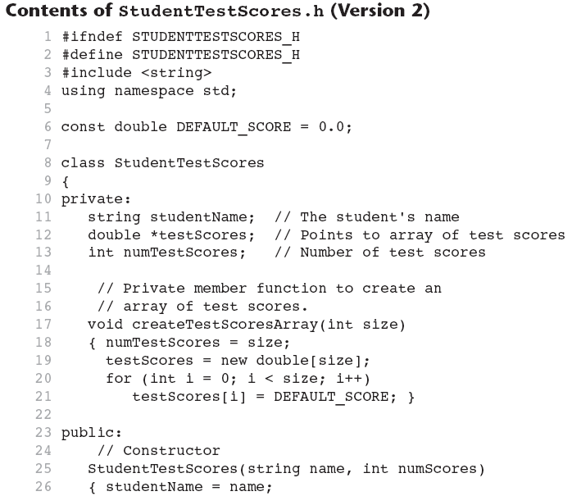

Slide 25
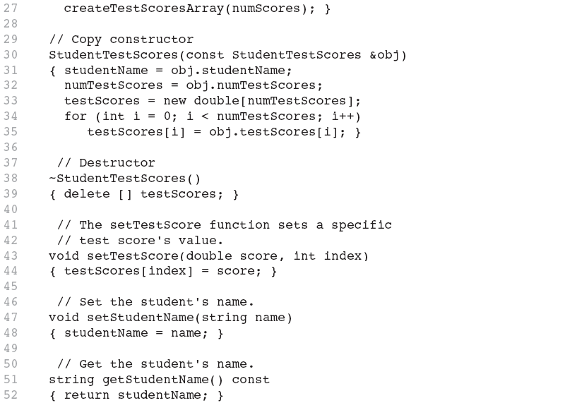

Slide 26
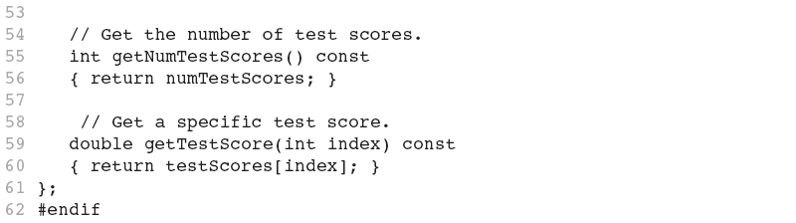

Slide 27
14.5
Operator Overloading

Slide 28
Operator Overloading
Operators such as =, +, and others can be redefined when used with objects of a class
The name of the function for the overloaded operator is operator followed by the operator symbol, e.g.,
operator+ to overload the + operator, and
operator= to overload the = operator
Prototype for the overloaded operator goes in the declaration of the class that is overloading it
Overloaded operator function definition goes with other member functions

Slide 29
The this Pointer
this: predefined pointer available to a class’s member functions
Always points to the instance (object) of the class whose function is being called
Is passed as a hidden argument to all non-static member functions

Slide 30
The this Pointer
Example, student1 and student2 are both StudentTestScores objects.
The following statement causes the getStudentName member function to operate on student1: cout << student1.getStudentName() << endl;
When getStudentName is operating on student1, the this pointer is pointing to student1.

Slide 31
The this Pointer
Likewise, the following statement causes the getStudentName member function to operate on student2: cout << student2.getStudentName() << endl;
When getStudentName is operating on student2, the this pointer is pointing to student2.
The this pointer always points to the object that is being used to call the member function.

